Slide 1

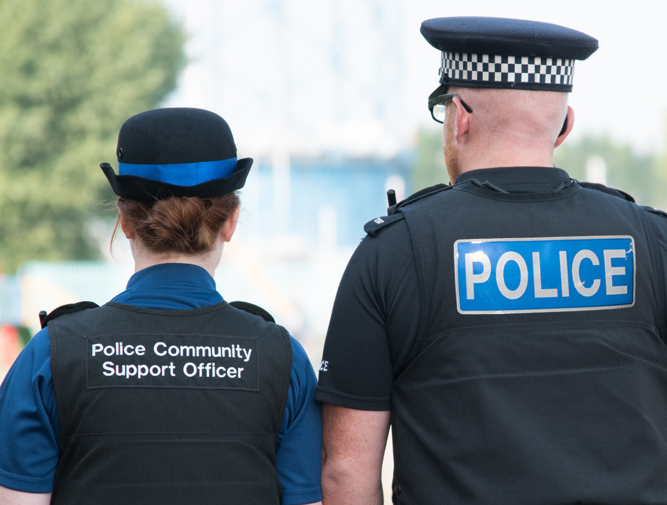
Police Community Engagement
A Crime Prevention stall will be in place for you to speak to a Neighbourhood Officer about any local safety concerns or to seek safety advice
Location: Hartley Library
Date: Tuesday 6th October
Time: 0930 to 1030
Speak to your local officer about any advice for crime prevention.
Your local officer will see people individually on a first come, first served basis.
Please see notice board for future dates and any changes.
For news, safety advice and information about policing in your area, visit www.kent.police.uk

